Slide 1
Model Zoo + Tutorials SIG
ONNX Workshop, 04/09/20
Vinitra Swamy, Microsoft

Slide 2
Formalized Charter
The Model Zoo and Tutorials SIG is responsible for the comprehensive collection of state of the art ONNX models from a variety of sources and making it easy for users to get started with ONNX and the ecosystem around it.
Concretely, this SIG has ownership over:
onnx/tutorials
onnx/models
tutorials located in onnx/onnx-docker
Instructive blog posts
Conference participation

Slide 3
Updates
SIG Mission Statement
Proposed Models – list of state-of-the-art models we want to add to the Model Zoo
Community Events – tracking upcoming ONNX events
Developing Model Zoo CI
Moving all ONNX Models to Git LFS: onnx/models#271
Enables a one line command to download all models: onnx/models#276
ONNX Docker containers (onnx/onnx-docker#40, onnx/onnx-docker#45)
onnx-base: Use published ONNX package from PyPi with minimal dependencies.
onnx-dev: Build ONNX from source with minimal dependencies.
onnx-ecosystem: Jupyter notebook environment for getting started quickly with ONNX models, ONNX converters, and inference using ONNX Runtime.

Slide 4
On our horizons
Guidelines -- Model Zoo / Tutorial entry guidelines, standardized experience
Discoverability -- exposing materials on the ONNX website
Analytics -- exploring various solutions to track Model Zoo Github usage
Participation -- ~10 members (Microsoft, IBM, nVidia), always looking for more
First meeting was January 30, 2020

Slide 5
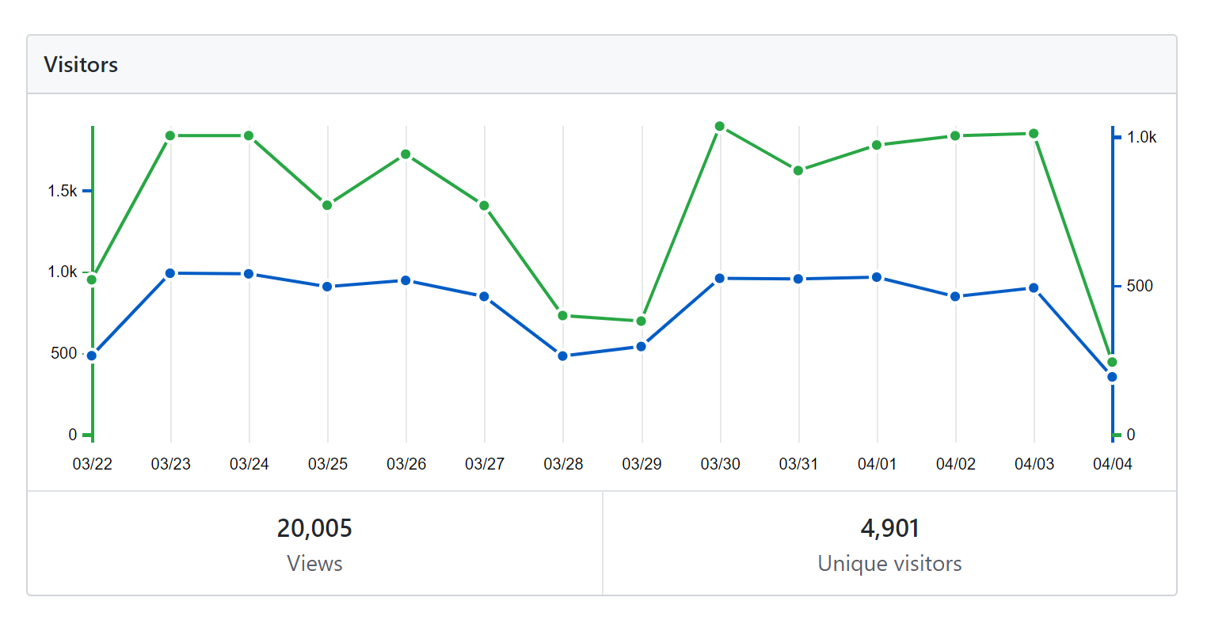
ONNX Model Zoo Traffic
103 clones in 2 weeks – ResNet, MobileNet, TinyYoloV2 are most popular pages

Slide 6
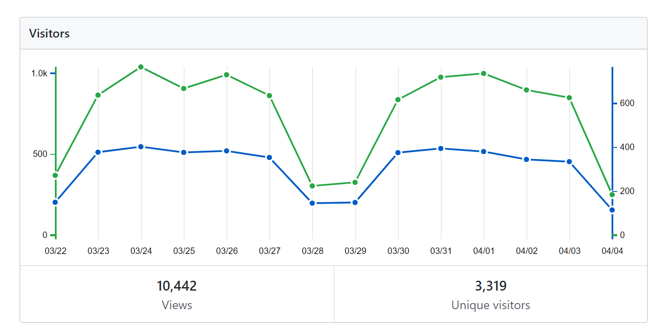
ONNX Tutorials Traffic
46 clones in 2 weeks – PyTorch, Tensorflow, MNIST, Model Visualization most popular

Slide 7

Join us!
Gitter: https://gitter.im/onnx/modelzoo
Github: onnx/sigs/models-tutorials
Next meeting: April 13th, 2020

